Slide 1
Logistic Regression

Slide 2
Today . . .
  Diagnostics
  Situations requiring more than two response categories—the multinomial model
  Ordinal categorical outcomes

Slide 3
The purpose of model diagnostics is to verify assumptions, identify potential problems, and explore the impact of features in the data that might threaten the validity of inferences.
Binary logistic regression shares many of the same assumptions of OLS regression:
  All important predictors are included (model is sufficient).
  No extraneous variables are included.
  Predictors are measured without error.
  Observations are independent.
  Independent variables are not linear combinations of each other.

Slide 4
In addition, binary logistic regression assumes that the true conditional probabilities are a logistic function of the independent variables.
As in OLS regression, we are concerned about unusual or overly influential cases in logistic regression. Influential data points alter the analysis out of proportion to their numerical representation in the data. They can be detected in logistic regression using the same basic diagnostic indices as used in OLS regression:
Residuals
Leverages
Cook’s distances (or DFFITS)
DFBETAS

Slide 5
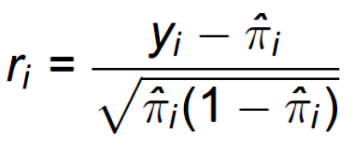
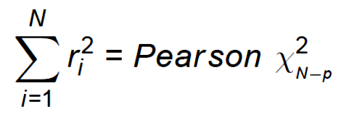
Residuals indicate lack of fit for each case and can be constructed in quite a few ways in logistic regression. One common form is the Pearson residual:
in which y_{i} is the observed response (0 or 1) and π_{i} is the predicted probability of a response. Each squared residual is a χ² variable with df = 1. The sum of the individual χ² is also a χ² variable:

Slide 6
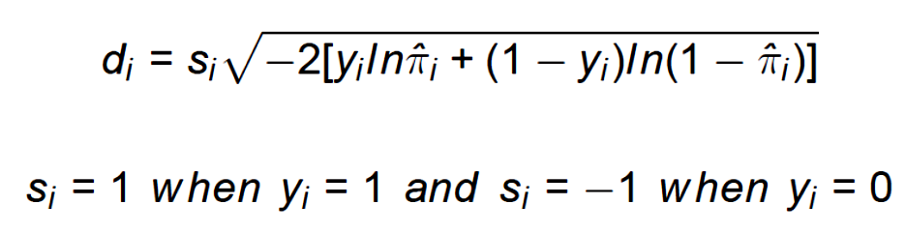
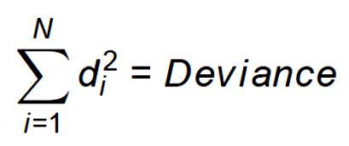
A second major residual is the deviance residual:
Summing the squared deviances produces the deviance for the entire model (= -2LL). In other words, the deviance residual has the convenient interpretation that it represents each case's contribution to the model's badness of fit:

Slide 7
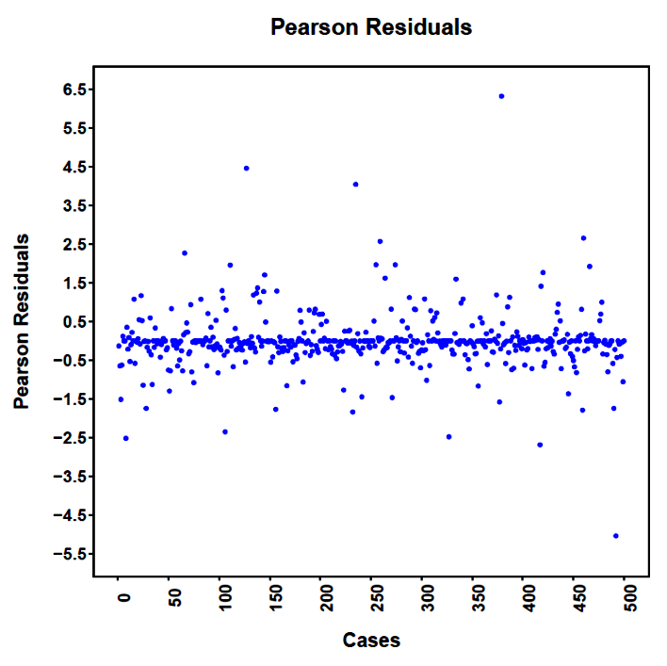
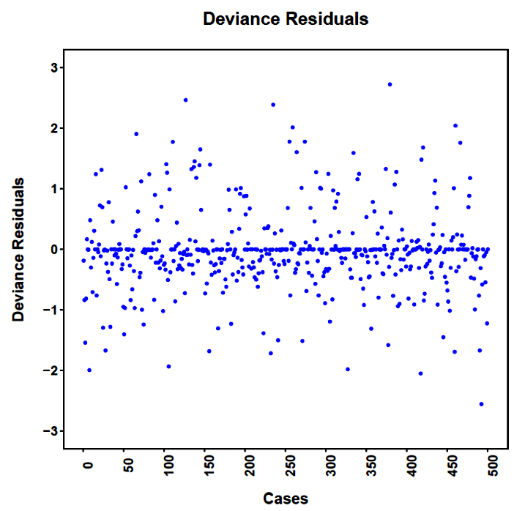
Nothing too awful is apparent in the case-wise display of these residuals. These residuals can also be standardized and studentized to help isolate oddballs more easily.

Slide 8
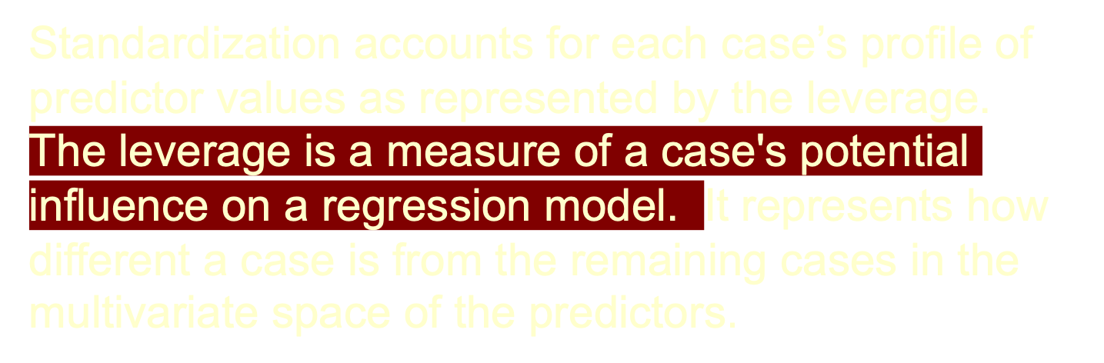
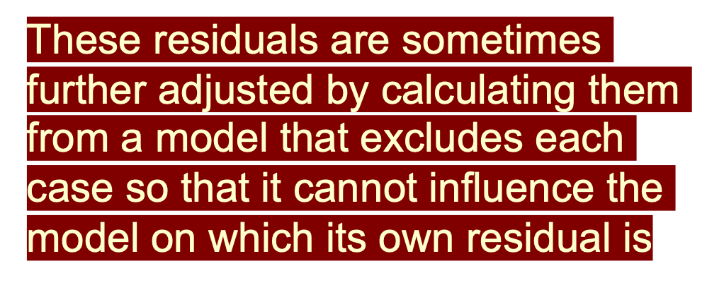
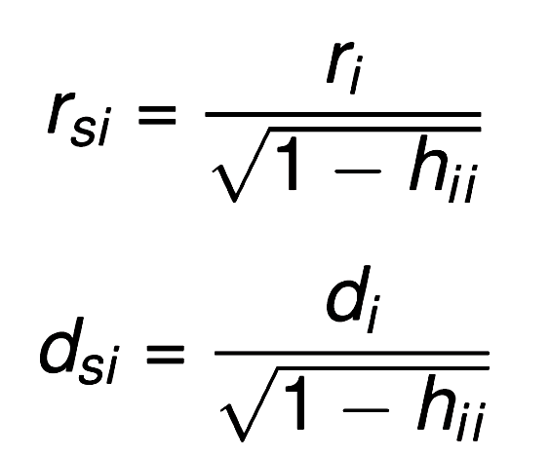
Notes:
Studentized residuals follows the t distribution. All of these residuals tend to be very highly related.
It is sometimes easier to identify unusual cases with standardized and studentized residuals.

Slide 9

The leverage is a measure of a case's potential influence on a regression model. It comes from the diagonal of the "hat" matrix and represents how different a case is from the remaining cases in the multivariate space of the predictors. They are sometimes called the “hat” values.
As leverage gets larger it indicates that a case has the potential to have more influence than it should. The leverage has a close relationship with the Mahalanobis distances for the predictors.

Slide 10
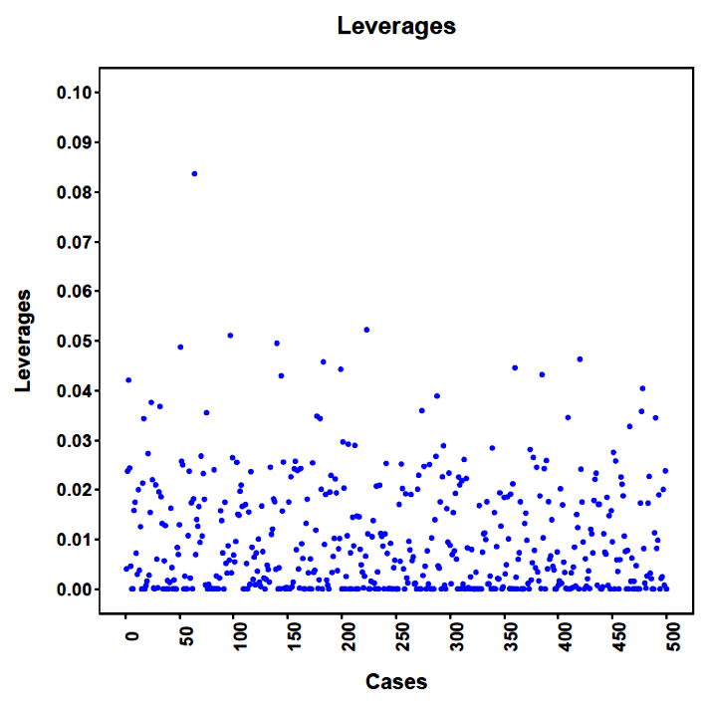

One case stands out as a bit more extreme than the others.
Case 64

Slide 11
Cook's distance is a general measure of influence that combines information about residuals and leverages. It is a scaled change in the fitted values that arises from eliminating each case in turn from the model. The scaling takes into account the leverage for each case.
Cases with unusual Cook's distances are cause for concern because they are influencing the model fit out of proportion to their numerical representation in the data.

Slide 12
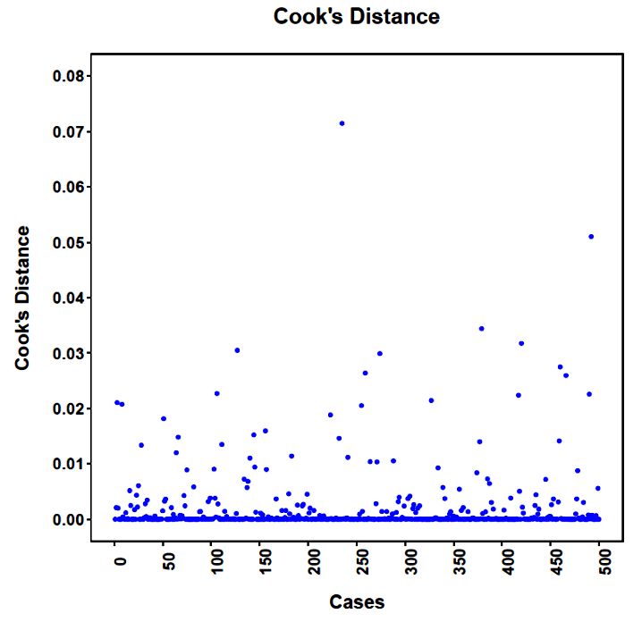

Here, too, there is one case that stands out a bit.
Case 235

Slide 13
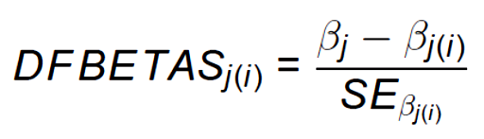
Cook's distance is a general measure of influence.
DFBETAS is coefficient-specific influence:
In other words, it is the standardized amount by which a coefficient changes when a case is excluded from the model.

Slide 14
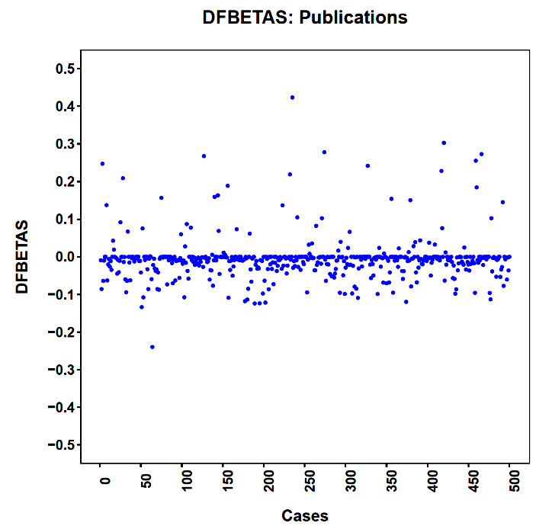
Same case as for Cook’s distance.
To see the effect on inferences, we could remove the case and re-run the analysis.
Case 235

Slide 15
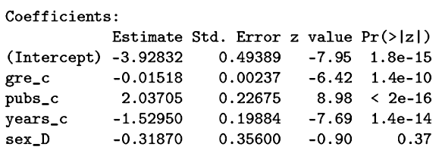
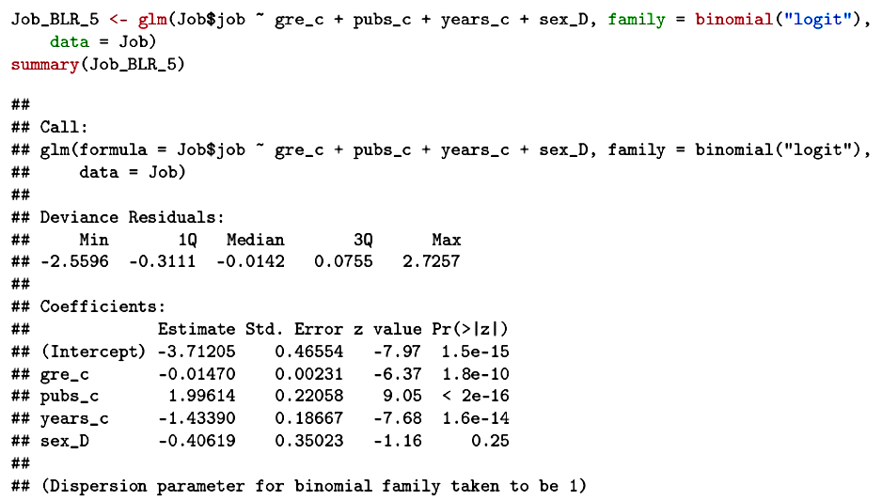
Original
No change in the inferences when the most unusual case is removed.

Slide 16
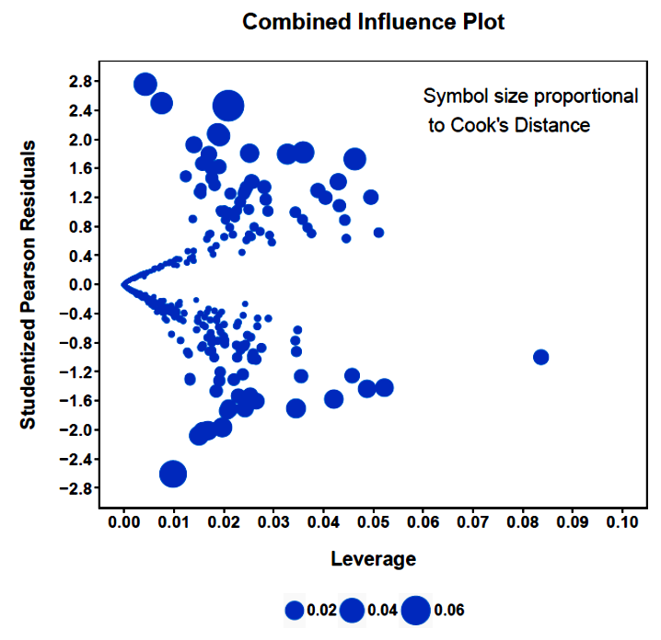
All of the information can be displayed at once.

Slide 17
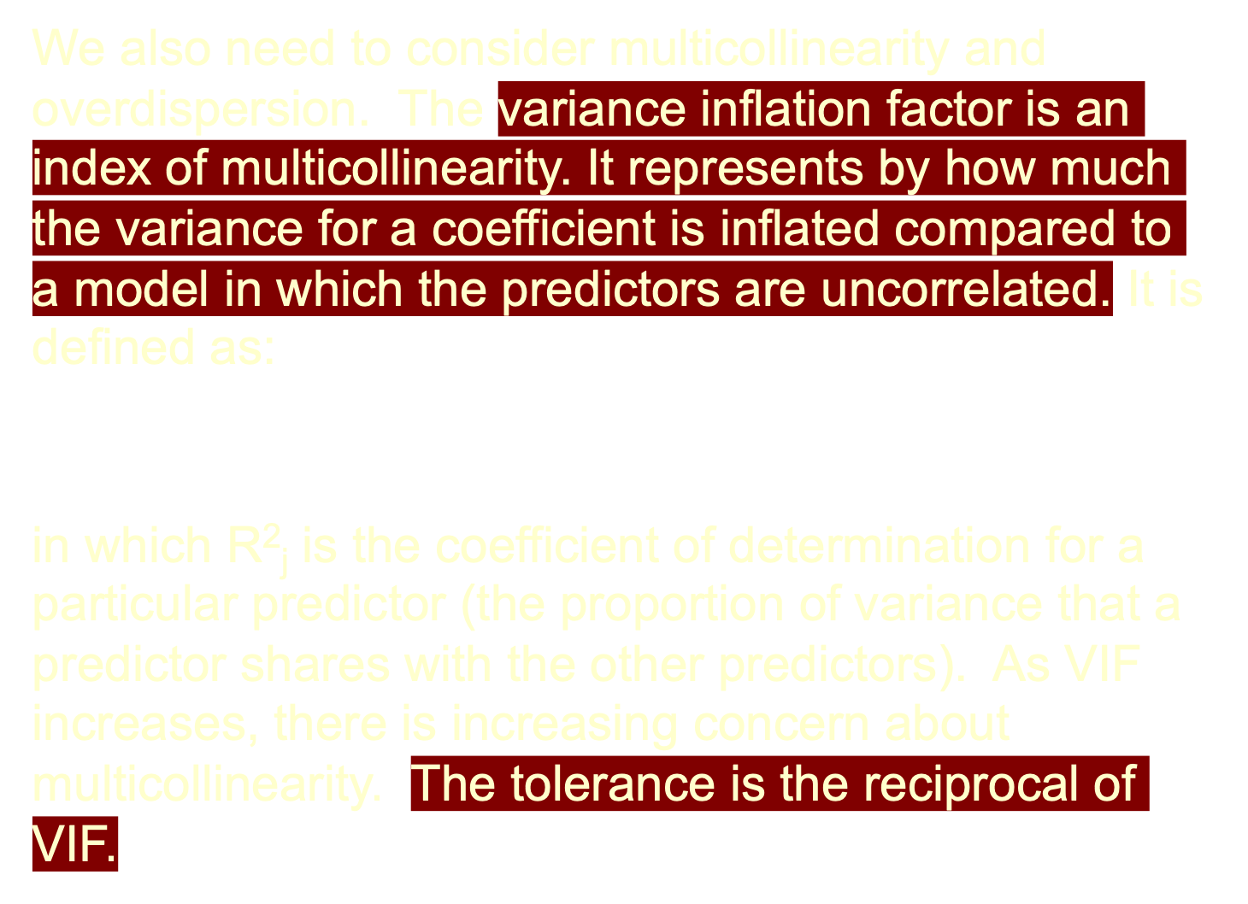
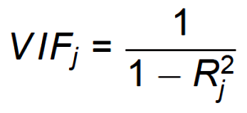

Slide 18
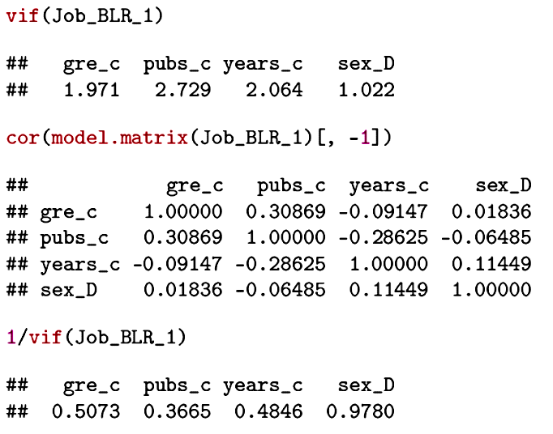
The predictors show low to moderate multicollinearity.

Slide 19
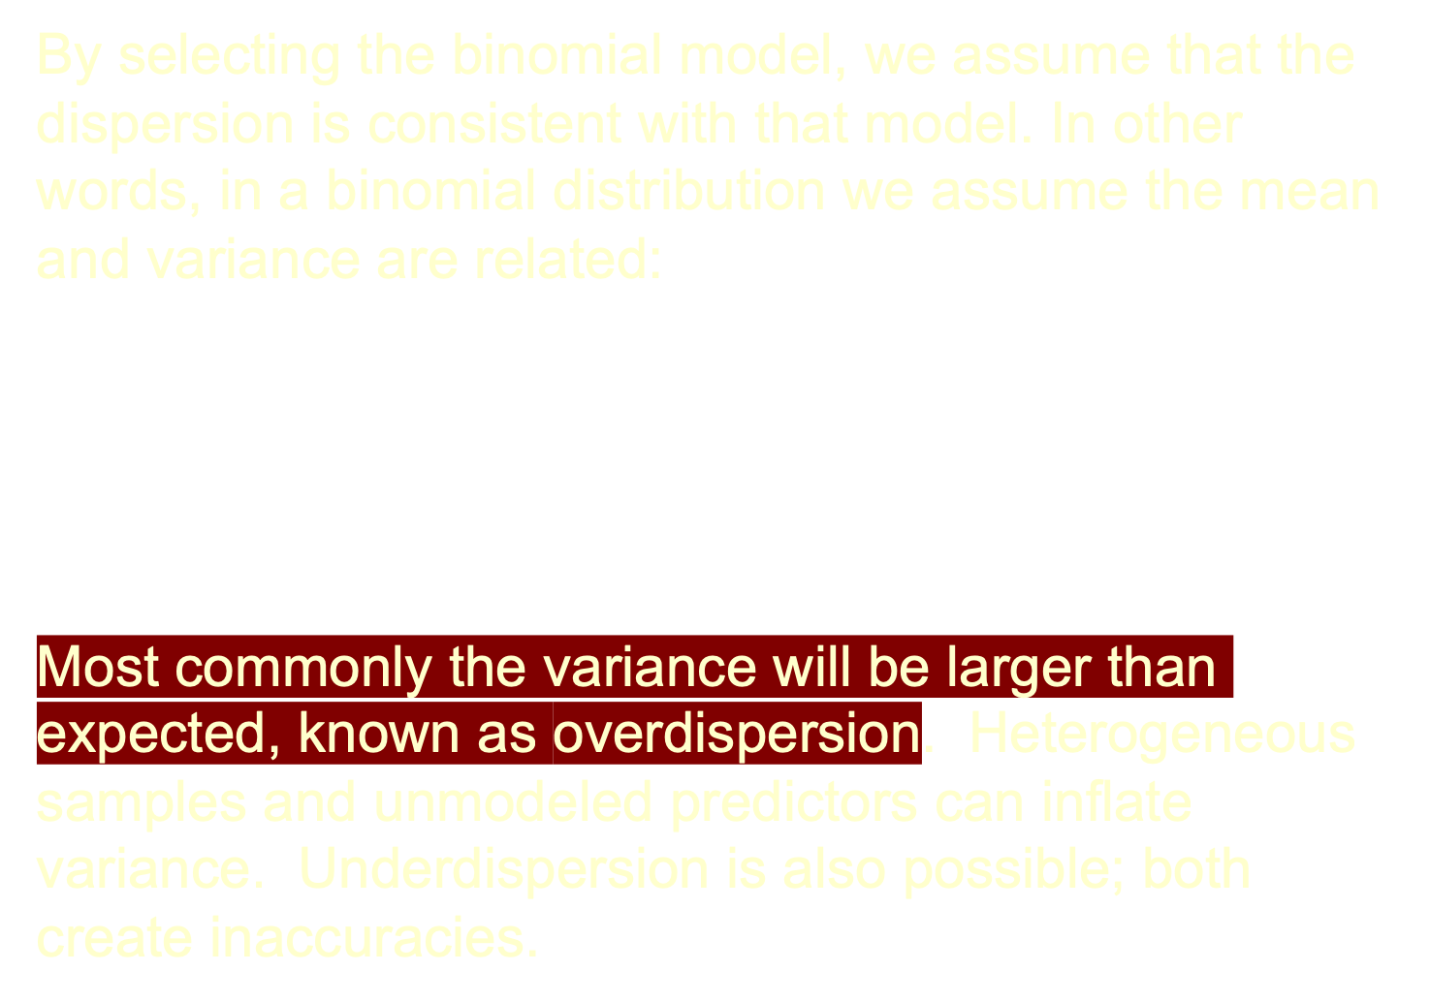
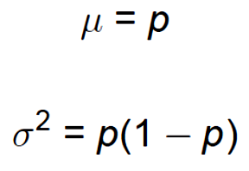
Notes:
The quasi-binomial family allows for the variance to be separately estimated, providing for overdispersed (and underdispersed) models. The negative binomial is another alternative.

Slide 20
Original model
*

Slide 21
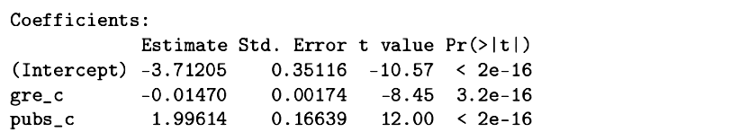
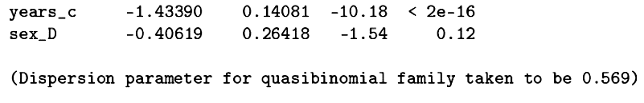
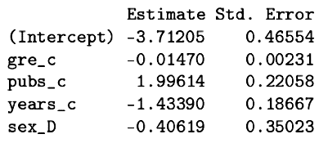
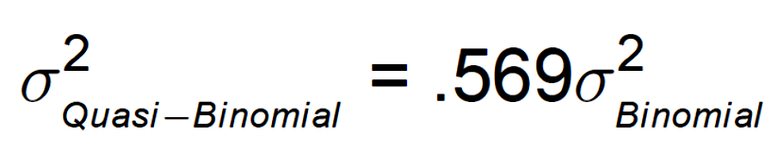
*
Binomial model

Slide 22

If the model follows the expected binomial distribution, this χ² has an expected value of N-p, its degrees of freedom. This can be used as a test of the acceptability of the underlying model. The most common violation is overdispersion.

Slide 23
Is the logistic model adequate? To test this, we can save the fitted logistic values, square them, and then enter them as an additional predictor in the model. This tests if there is any relationship beyond a linear logistic in the data. The coefficient for this new predictor should be clearly nonsignificant.

Slide 24
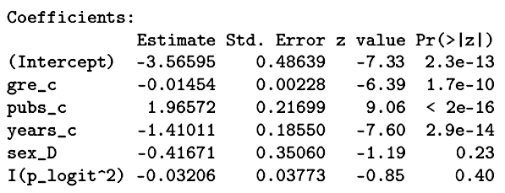
No need to consider a different link function. The logit link is working just fine.

Slide 25
Overall, the data are fit well by a binary logistic model. There are no truly unusual cases. The predictors are reasonably independent. If anything, the model is underdispersed, and so is conservative compared to a truly binomial distribution.

Slide 26
When there are more than two categories for the outcome variable, multinomial logistic regression is used. It might be useful for other problems as well.
  Rating scales with more than 2 (crude) levels
  Doubts about the interval or ordinal nature of a rating scale
  Interest in particular levels of a rating scale (e.g., neutral).
  Messy outcomes
  Patterns of outcomes (including some repeated measures)

Slide 27
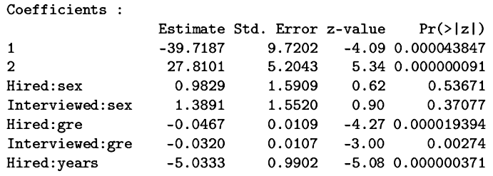

In multinomial logistic regression, one of the outcome categories is chosen as the reference. Each of the remaining outcome categories are compared to the reference, akin to a collection of binary logistic regressions.

Slide 28
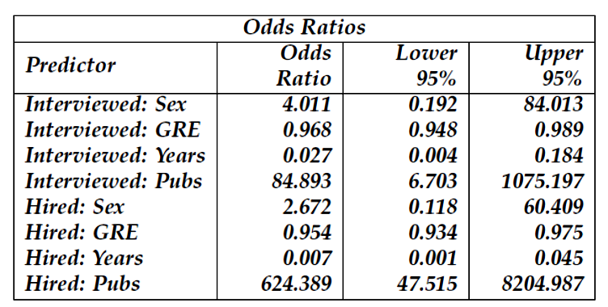
Each publication multiplies the odds of getting an interview versus not getting an interview by 84.9. Each publication multiplies the odds of getting hired versus not getting an interview by 624.4.

Slide 29
Each year to complete multiplies the odds of getting an interview versus not getting an interview by .027. This represents a 97.3% decrease in the odds of getting interviewed.

Slide 30
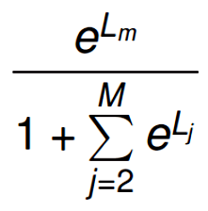
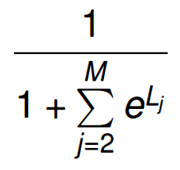
Logits for each model are calculated in the usual fashion. Probabilities are a little more complicated.
For outcomes, m=2 to M, the probability of outcome, m:
For the reference category, m = 1, the probability is:

Slide 31
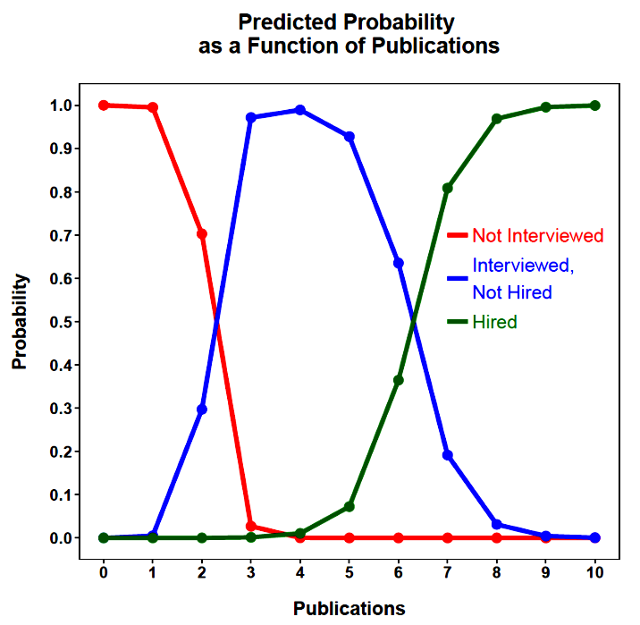
These probabilities assume other predictors are constant at their means.

Slide 32
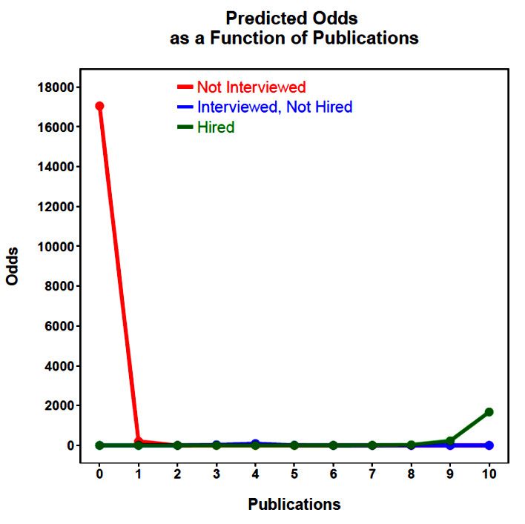

Slide 33
If the outcome categories have an order, that information can be used in the analysis. There are several varieties of ordinal logistic models, the most common being the proportional odds model.
This means that predictors are constrained to have a constant influence across ordinal transitions.

Slide 34
The logistic regression attempts to find the linear model that distinguishes the outcome groups defined by successive divisions along the ordinal scale.
  1 = Not interviewed
  2 = Interviewed but not hired
  3 = Hired
What is the probability that someone will not be interviewed?
What is the probability that someone will either not be interviewed or be interviewed but not hired?

Slide 35
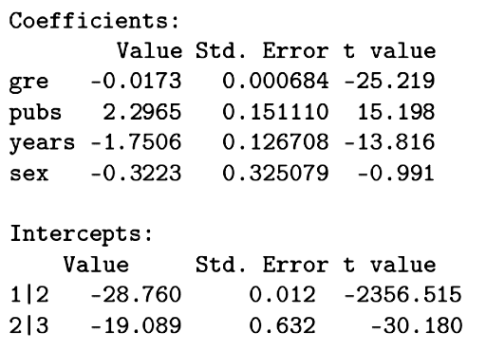
If the assumptions hold, most notably the proportional odds assumption, then the ordinal regression is simpler and easier to estimate and interpret than a multinomial regression for the same data.
Each coefficient refers to a binary distinction along the ordinal outcome scale. The same coefficients apply to all distinctions. Note different intercepts.

Slide 36
The logits are calculated for a particular cut-point. They can then be converted to probabilities, but these are cumulative probabilities for the outcomes at or below the given cut-point.
The probabilities of a particular outcome can be calculated through subtraction:

Slide 37
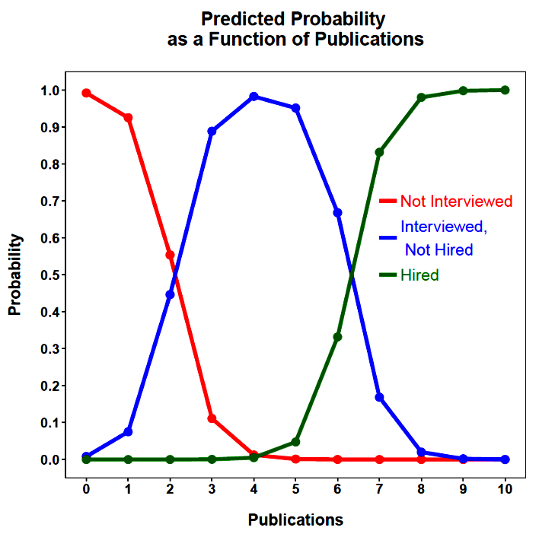
Transition points can be identified that show where outcomes become more probable than those preceding it on the ordinal scale.

Slide 38
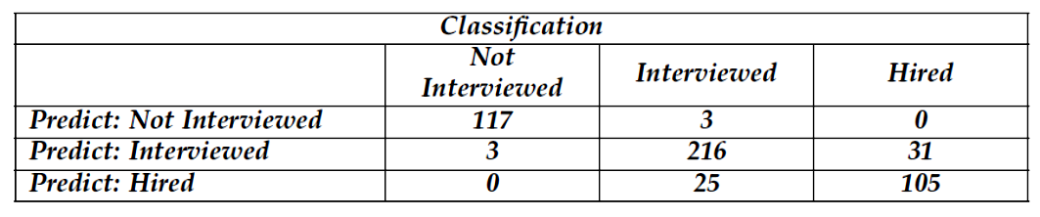
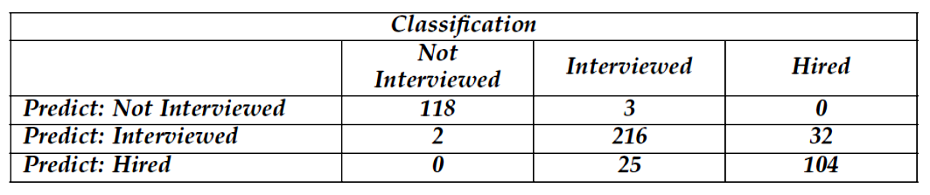
Despite the more restrictive model, classification is still impressive and comparable to the multinomial model in which separate coefficients were estimated for each binary comparison.
Multinomial
Ordinal

Slide 39
Next time . . .
MANOVA

